Slide 1
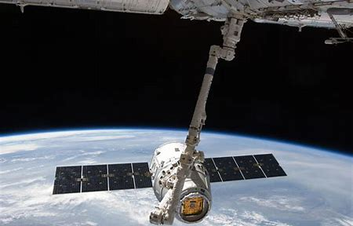
COURSE OVERVIEW
LGEORGE2@UCCS.EDU

Slide 2
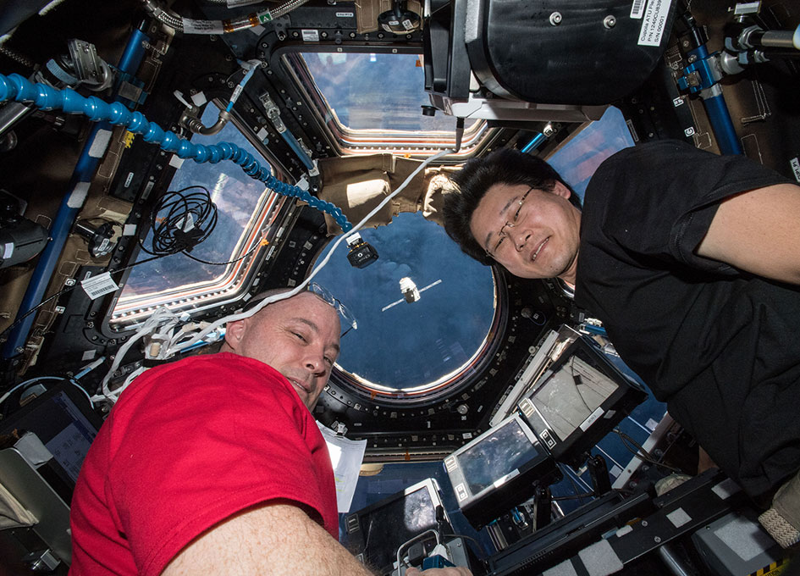
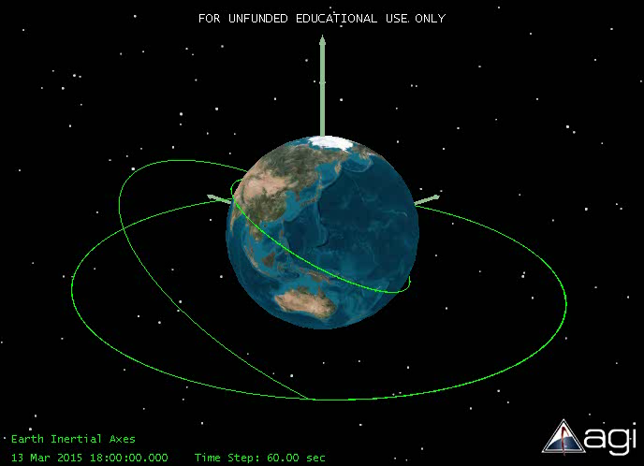
ORBITAL MOTION
Astronaut wings – 57.5 mi (92.6 km)
Technically starts where a satellite will stay in orbit briefly, or ~ 81 mi (130 km)

Slide 3
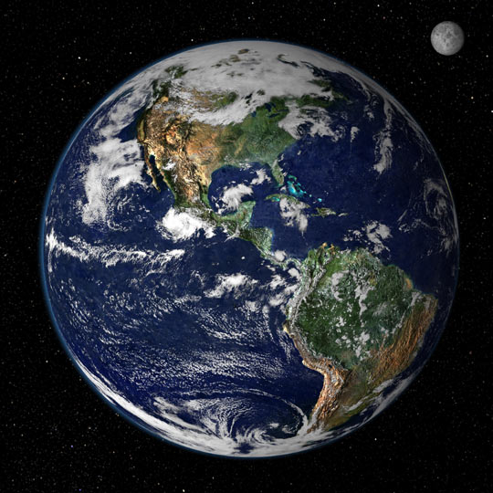
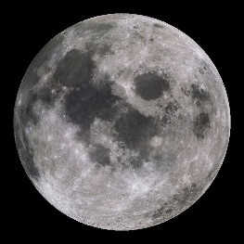
ORBITAL MOTION
Earth’s diameter ~ 12,800 km
Earth’s radius ~ 6378 km
LEO ~ 300 km altitude
Geo 3X dia of earth
~35,780 km alt
Moon
30X
384,000 km
Sun
12000X
150M km
Not to scale!

Slide 4
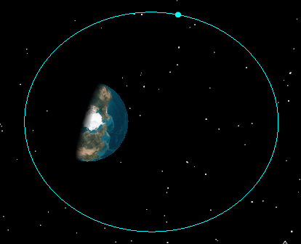
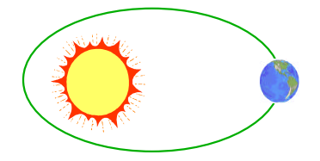

COURSE OVERVIEW
Newton’s Laws and Kepler’s Laws
Satellite
2-body equation of motion
Perigee
Apogee
$${\overset{⃑}{F}}_{g}$$

Slide 5
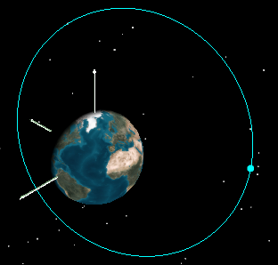





COURSE OVERVIEW
Classical orbital elements (COEs)
a = semi-major axis (orbit size)
e = eccentricity (orbit shape)
i = inclination (tilt)
Ω = right ascension of ascending node
(swivel)
ω = argument of perigee (locates perigee)
ƴ= true anomaly (locates satellite)
$$\hat{K}$$
$$\hat{I}$$
$$\overset{⃑}{V}$$
$$\overset{⃑}{R}$$
$$\hat{J}$$

Slide 6


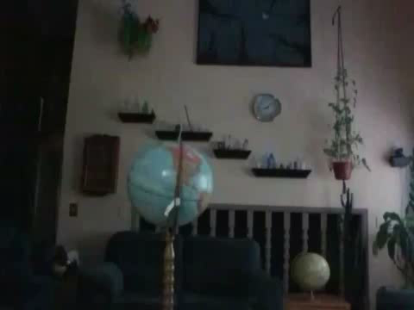



THE
CLASSICAL ORBITAL ELEMENTS
(COEs)

Slide 7
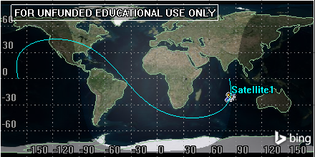
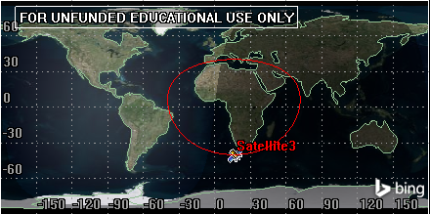
COURSE OVERVIEW
Ground Tracks

Slide 8
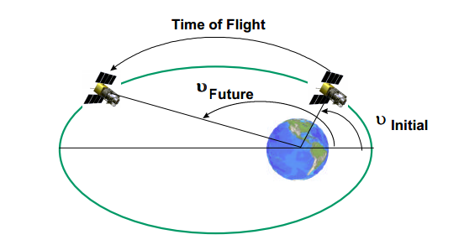
COURSE OVERVIEW
Kepler’s Prediction Problem

Slide 9
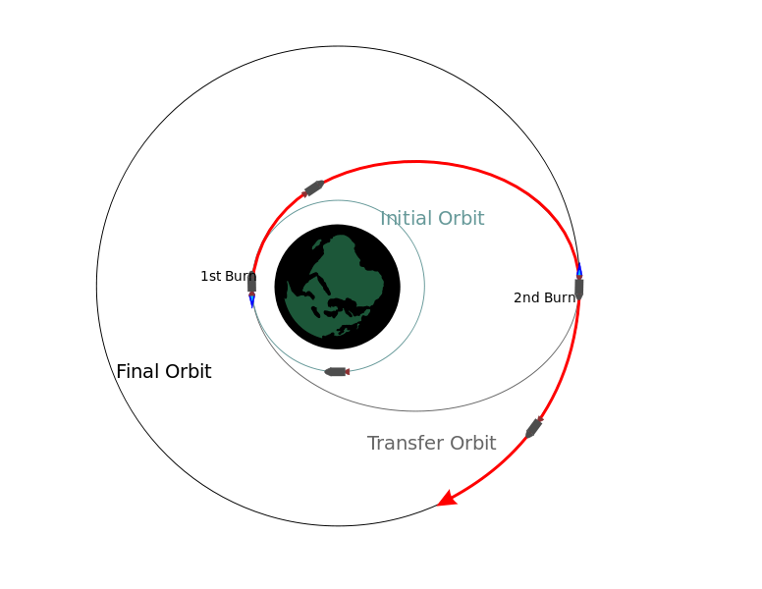
COURSE OVERVIEW
Maneuvering
Hohmann Transfers
Changes SIZE of orbit

Slide 10
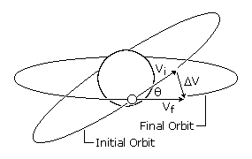
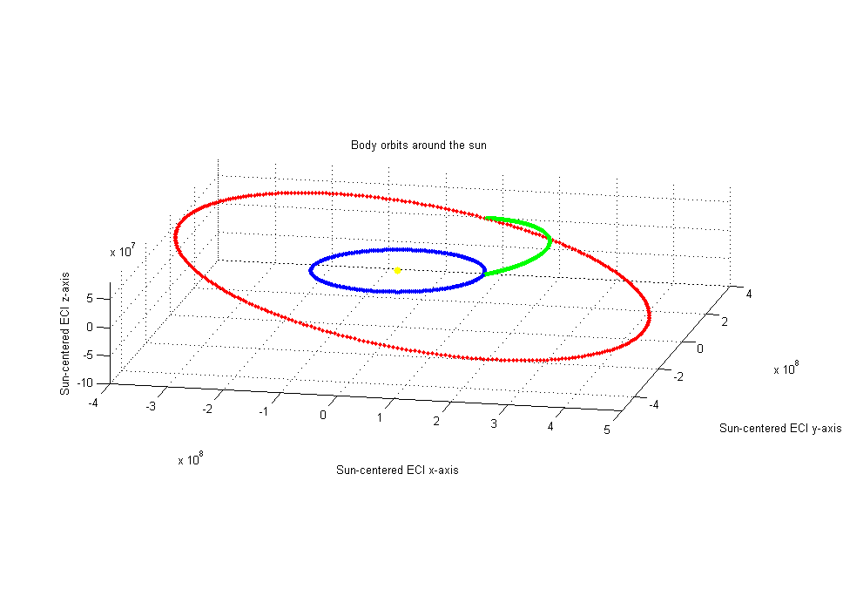
COURSE OVERVIEW
Maneuvering
Plane changes
change i or Ω
Combined plane changes
Change a and i
OR
a and Ω

Slide 11
COURSE OVERVIEW
Maneuvering
Rendezvous
  Co-planar
  Co-orbital
Dragon Resupply Mission to ISS

Slide 12
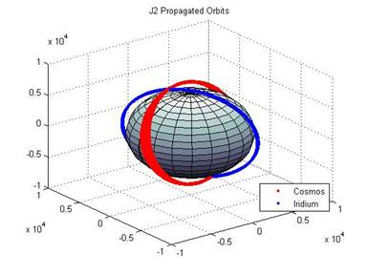
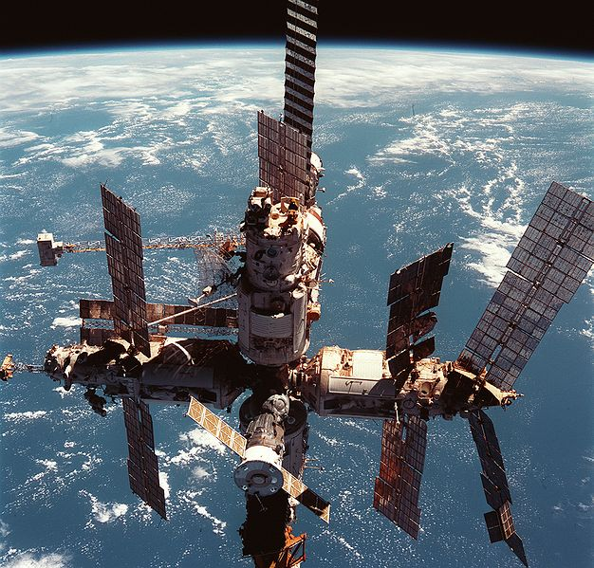
COURSE OVERVIEW
Russia’s MIR Space Station
Perturbations

Slide 13
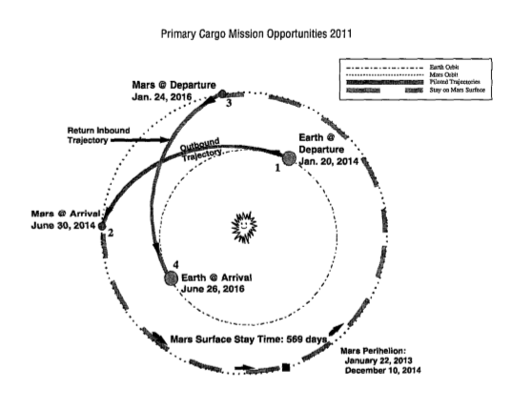
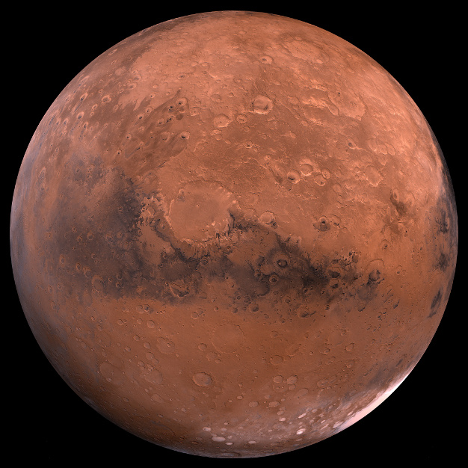
COURSE OVERVIEW
Interplanetary and Gravitational Assists

Slide 14
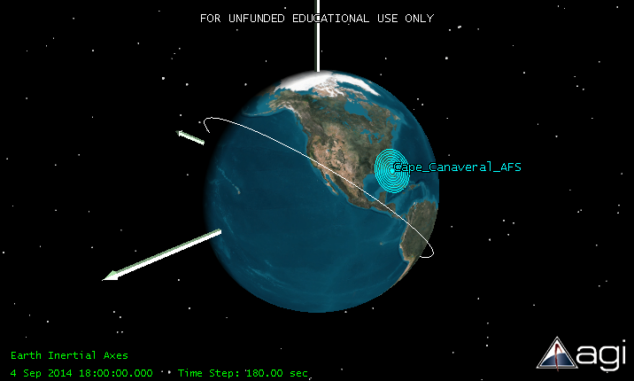
COURSE OVERVIEW
Launch Windows and Time

Slide 15
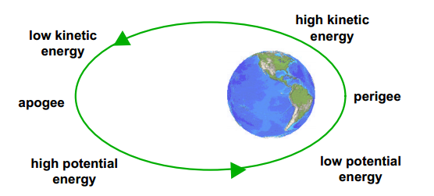
NEXT
Basics of orbital motion
Kepler’s Laws
Newton’s Laws
Energy Considerations
2 Body Equation of Motion

Slide 16
REFERENCES
AGI, Free Trial Options. (2021). https://licensing.agi.com/stk/
Convert Keplerian Orbital Elements to a State Vector. (n.d.). https://www.mathworks.com/matlabcentral/fileexchange/35455-convert-keplerian-orbital-elements-to-a-state-vector
Deorbit of Russia's Mir Space Station was 10 Years Ago Today. (2011, March 23). https://siliconcowboy.wordpress.com/2011/03/22/deorbit-of-russias-mir-space-station-was-10-years-ago-today/
Orbital Mechanics 101, page 1. (n.d.). http://www.abovetopsecret.com/forum/thread460766/pg1
Sellers, J. J., & Astore, W. J. (2021) Understanding space: An introduction to astronautics. New York: McGraw-Hill.

