Slide 1
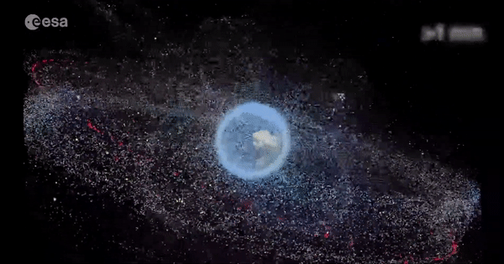
Fundamentals of ASTRODYNAMICS
Course introduction – types of space missions
Lynnane George
lgeorge2@uccs.edu

Slide 2
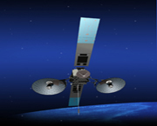
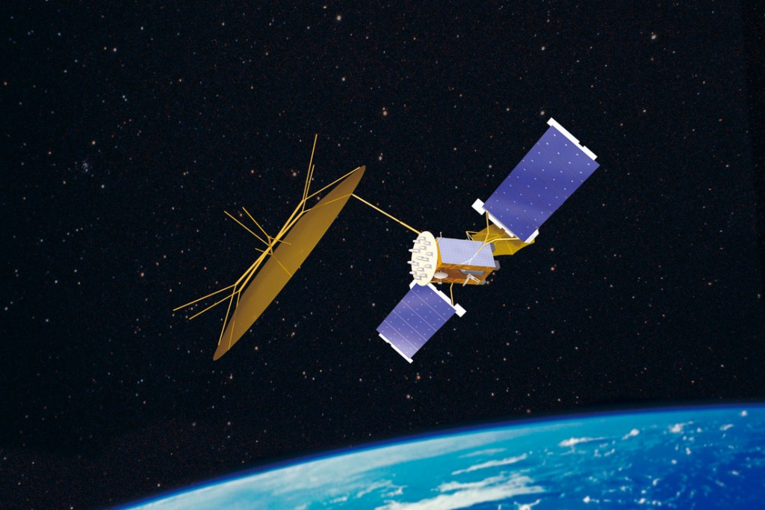
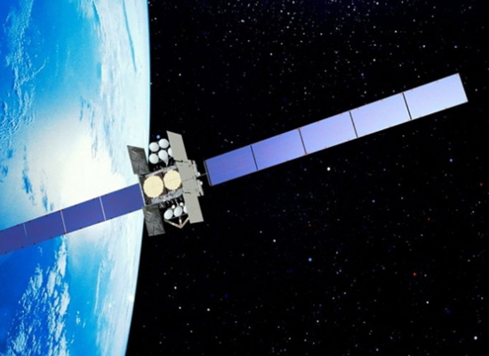
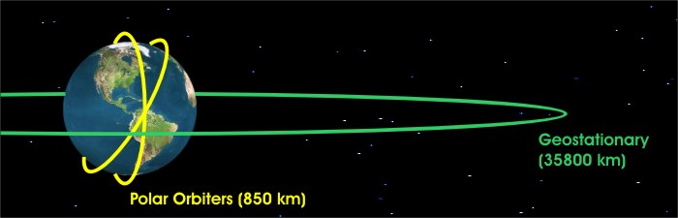
TYPES OF SPACE MISSIONS
Mobile User Objective System
1) Space-based communication
Tracking and Data Relay Satellite
Wideband Global Satcom

Slide 3


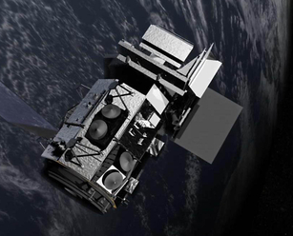
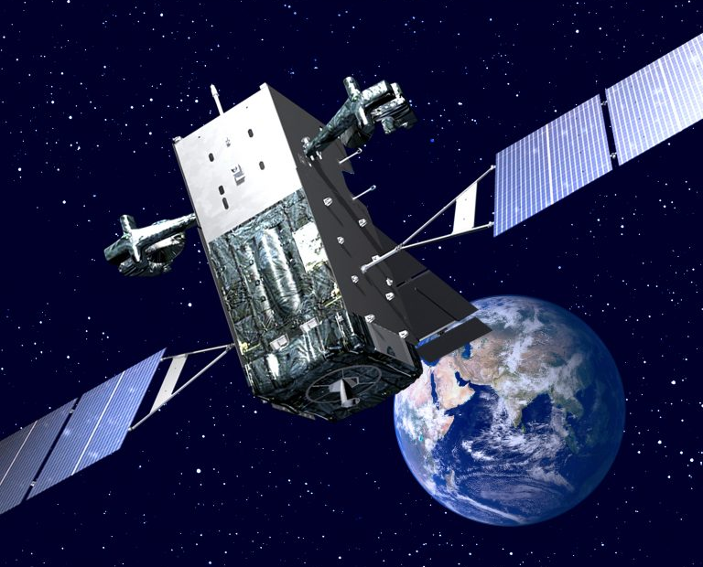


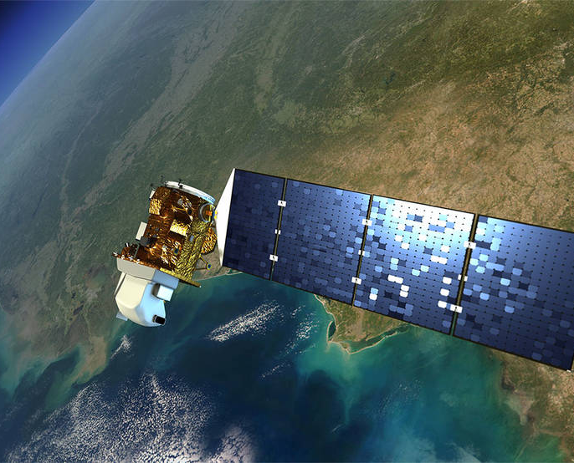
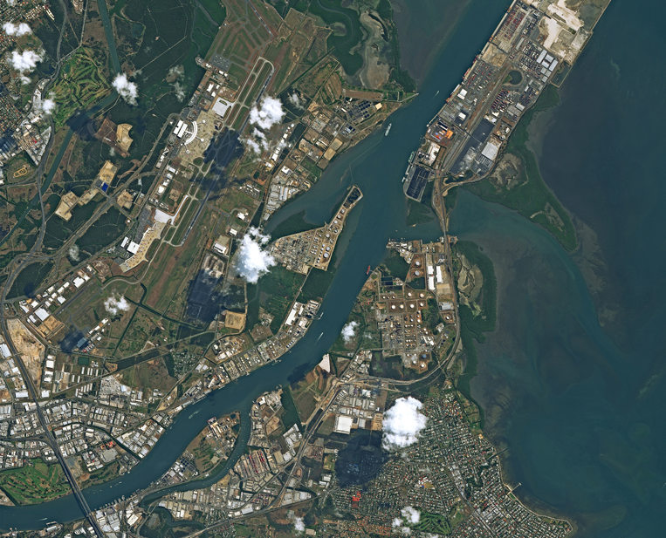

TYPES OF SPACE MISSIONS
Sentinel - 3
SBIRS
2) Remote Sensing
Landsat 8
SPOT Image

Slide 4
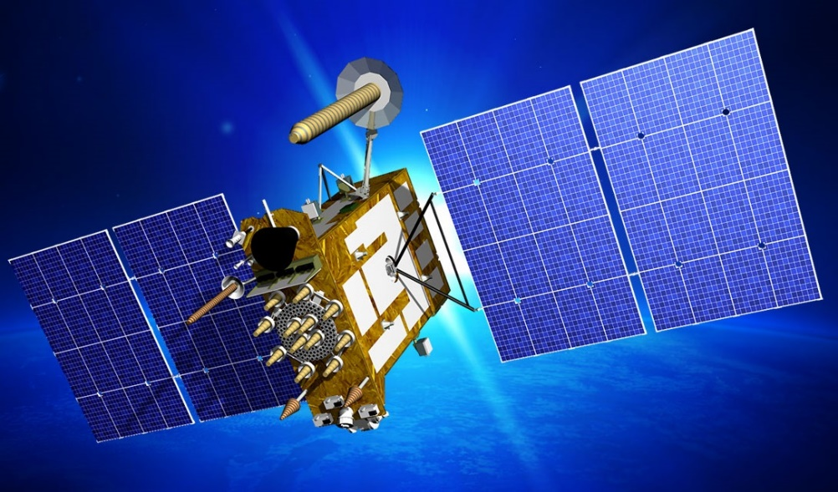
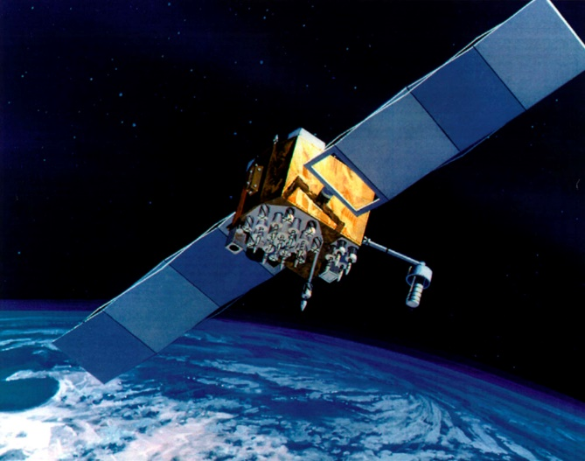
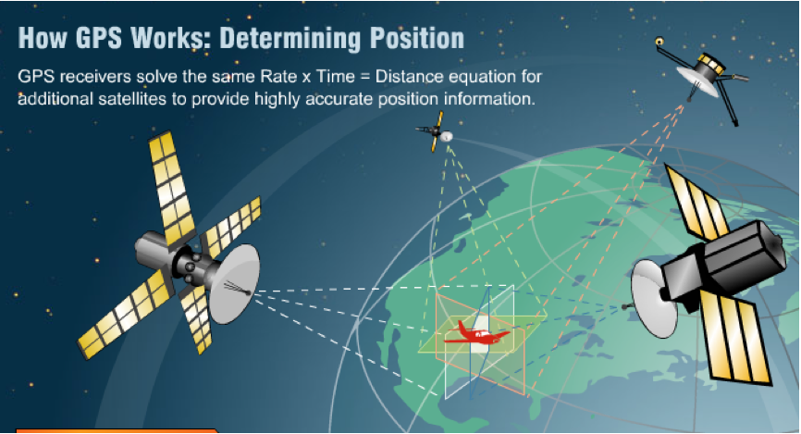
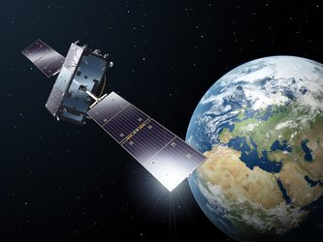
TYPES OF SPACE MISSIONS
GPS
GLONASS
GPS
3) GLSS: Global Navigation Satellite Services
GALILEO

Slide 5
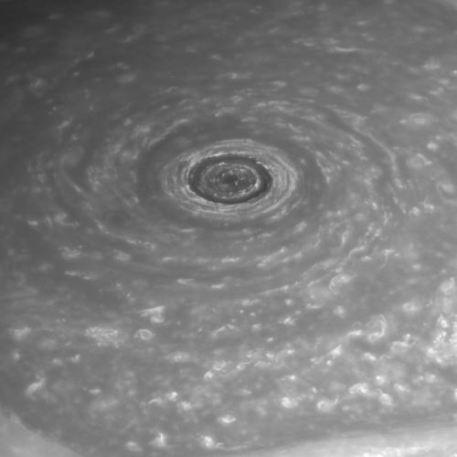
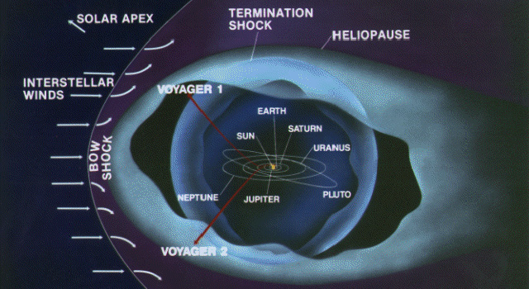
TYPES OF SPACE MISSIONS
4. Science and Exploration
Cassini image: The Eye of Saturn

Slide 6
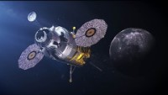
FUTURE SPACE MISSIONS

Slide 7
REFERENCES
Blau, P. (2017, September 23). Glonass Satellite Blasts Off on Soyuz to Replenish Russian Navigation Constellation. https://spaceflight101.com/soyuz-glonass-m-52-launch/
Dunbar, B. (2015, May 01). Tracking and Data Relay Satellite (TDRS) Fleet. https://www.nasa.gov/directorates/heo/scan/services/networks/tdrs_fleet
Flybys. (2019, March 20). https://solarsystem.nasa.gov/missions/cassini/mission/tour/flybys/?page=0
Jenner, L. (2015, April 01). Landsat Overview. https://www.nasa.gov/mission_pages/landsat/overview/index.html
MUOS. (2020). https://www.lockheedmartin.com/en-us/products/muos.html
NASA. (2020). https://spinoff.nasa.gov/
NASA's Cassini Spacecraft Obtains Best Views of Saturn Hexagon. (2013, December 04). https://www.jpl.nasa.gov/news/news.php?release=2013-350
Navigation. (2020). https://sentinel.esa.int/web/sentinel/missions/sentinel-3

Slide 8
REFERENCES
Observing Weather From Space. (2020). https://www.e-education.psu.edu/meteo3/l5_p2.html
Ray, J. (2014, December 18). Newest GPS satellite goes active. https://spaceflightnow.com/2014/12/18/newest-gps-satellite-goes-active/
SBIRS – Spacecraft & Satellites. (2020). https://spaceflight101.com/spacecraft/sbirs/
SPOT-6 Satellite Image of Brisbane, Australia. (2017). https://www.satimagingcorp.com/gallery/spot-6/spot-6-brisbane-australia/
SPOT 7. (2020). https://earth.esa.int/eogateway/missions/spot-7
Voyager - The Interstellar Mission. (2020). https://voyager.jpl.nasa.gov/mission/interstellar-mission/
WGS – Wideband Global Satcom – Spacecraft & Satellites. (2020). https://spaceflight101.com/spacecraft/wgs-wideband-global-satcom/
What is Galileo? (2020). http://www.esa.int/Applications/Navigation/Galileo/What_is_Galileo
Wu, K. (2019, December 12). The European Space Agency Is Sending a Robot to Hug Junk Out of Space. https://www.smithsonianmag.com/smart-news/european-space-agency-sending-robot-hug-junk-out-space-180973762/

Slide 9
VIDEOS
Air Force AEHF Mission Videos. (2013, July 29). https://youtu.be/bBCEECYmEcU
Blastoff! US Space Force's 1st launch is the AEHF-6 satellite. (2020, March 26). https://youtu.be/-zb3Qg6BadY
How Non-Stop Communications With Satellites Is Achieved by NASA: Video. (2014, January 23). https://youtu.be/iKDfTXeO2Aw
How Space Tech Is Changing Life on Earth: 2020 Edition. (2020, May 01). https://youtu.be/msBCjIISIjY
NASA: Continuing Landsat's 40-Year Legacy. (2013, January 29). https://youtu.be/q_Umv3aAdcA
NASA Spacecraft Use GPS in Distant Earth Orbit: Video. (2015, September 14). https://youtu.be/cufGSjYY_i4
TOP 7 FUTURE Space Missions. (2020, March 22). from https://youtu.be/gnw1E6FP0H4

