Slide 1

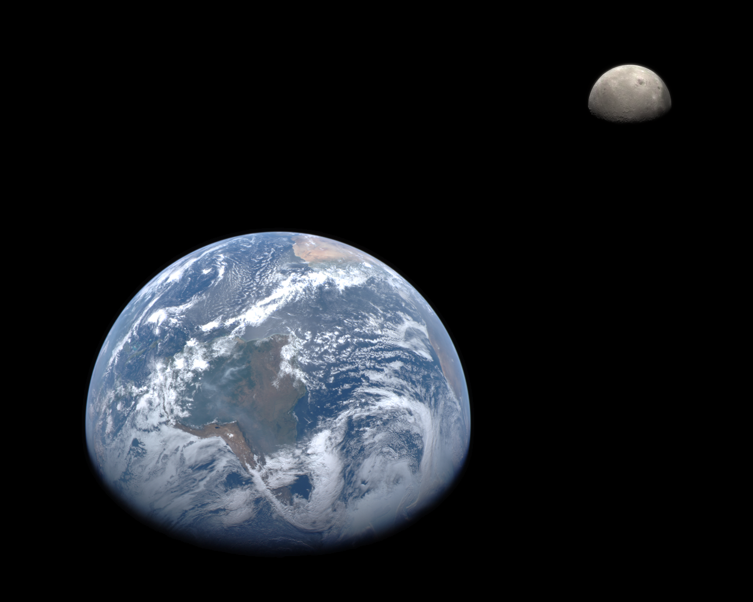
Fundamentals of ASTRODYNAMICS
Lynnane George
lgeorge2@uccs.edu

Slide 2
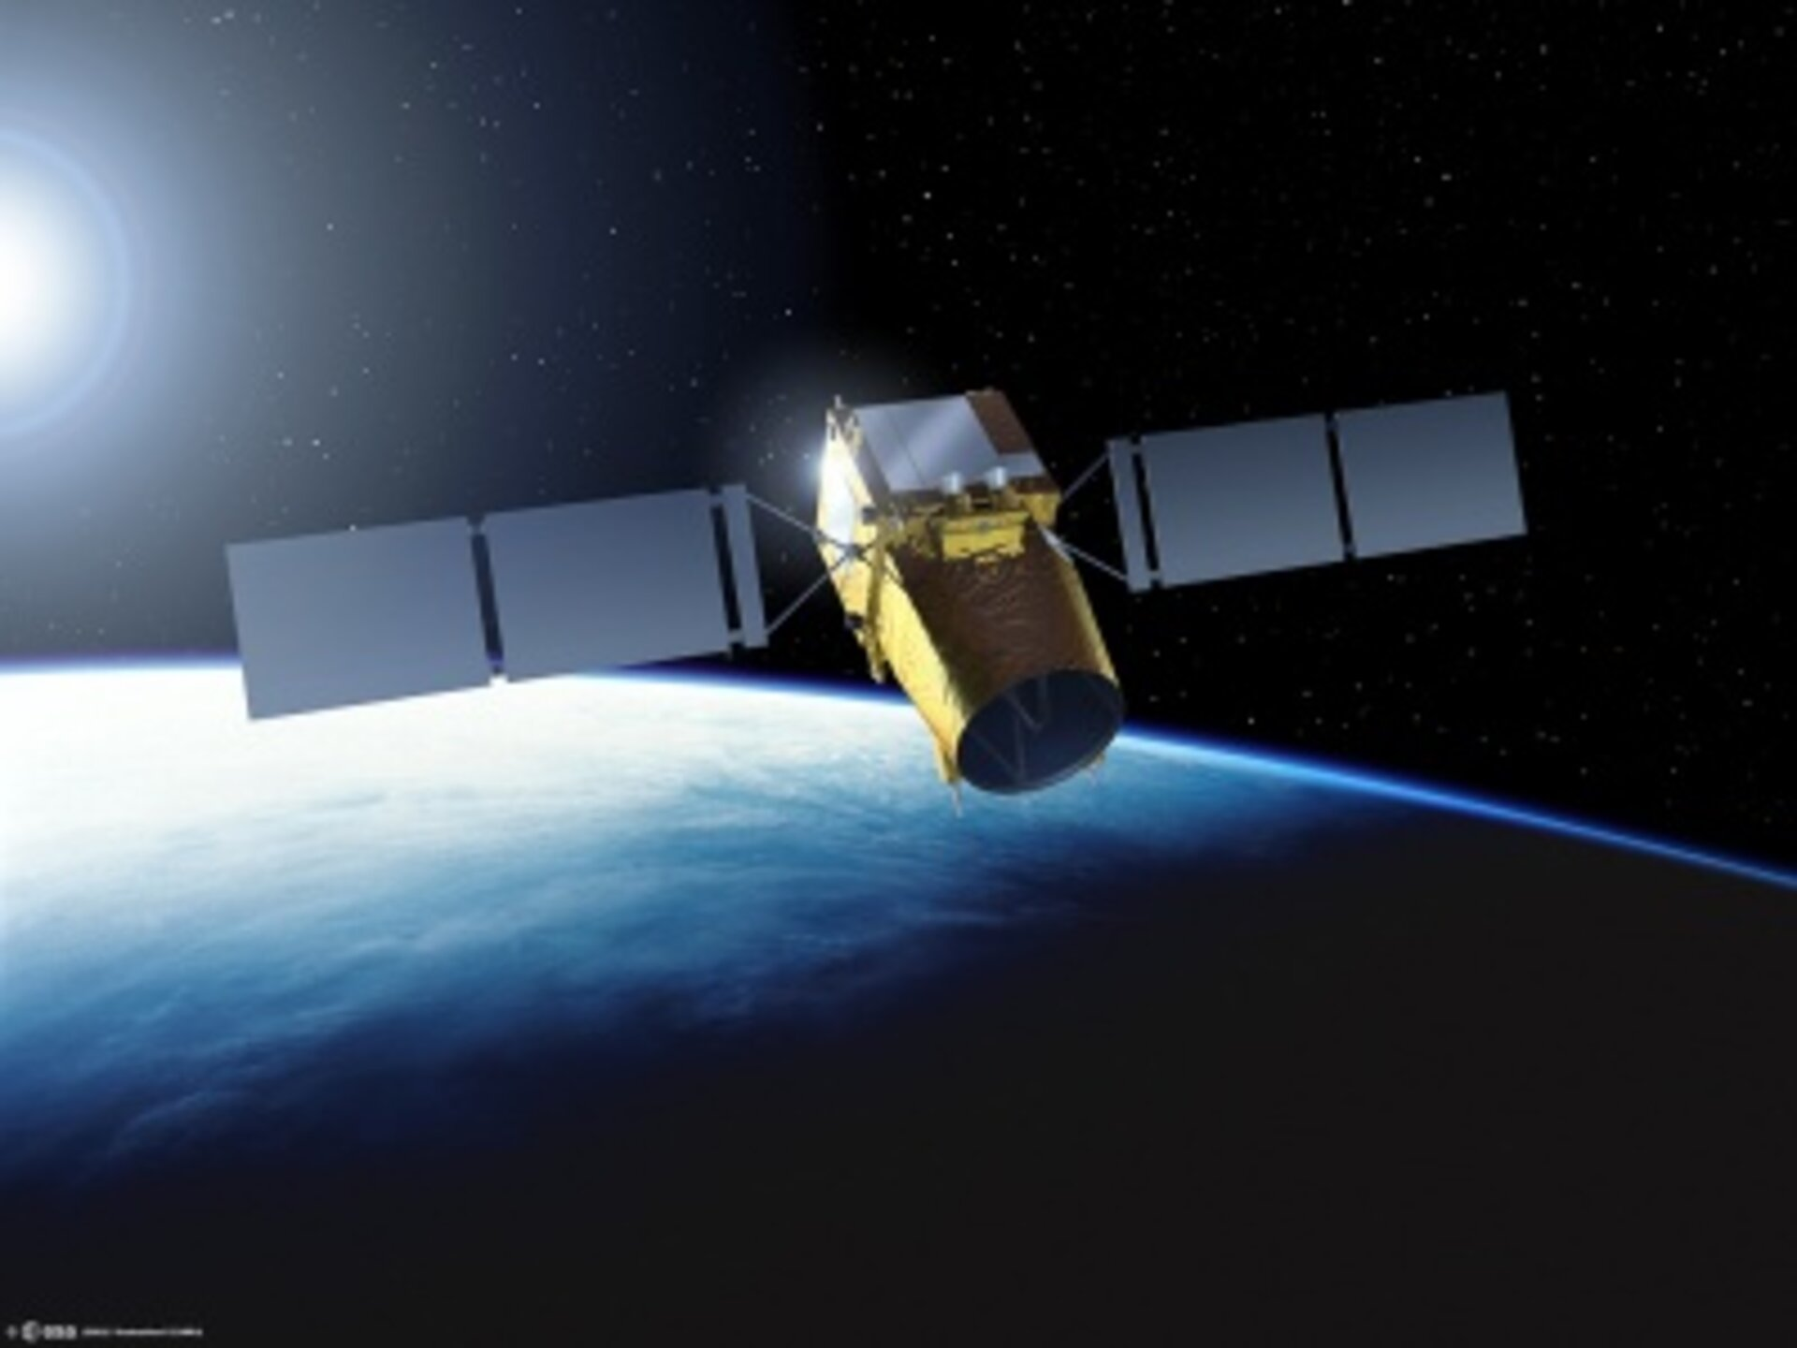
COURSE INTRODUCTION
Development and application of the fundamental principles of astrodynamics to satellite motion. Study of coordinate systems, time keeping, computation of orbits, and introduction to perturbation theory.
The course is divided into roughly EIGHT parts:
Introduction to orbital motion
The Classical Orbital Elements
Orbital maneuvering and rendezvous
Kepler’s prediction problem
Perturbations
Interplanetary travel
Launching into space
Introduction to advanced orbital mechanics
See COURSE SCHEDULE

Slide 3
WHY ARE WE HERE?
Notes:
Need to find a good video. This one is old.

Slide 4
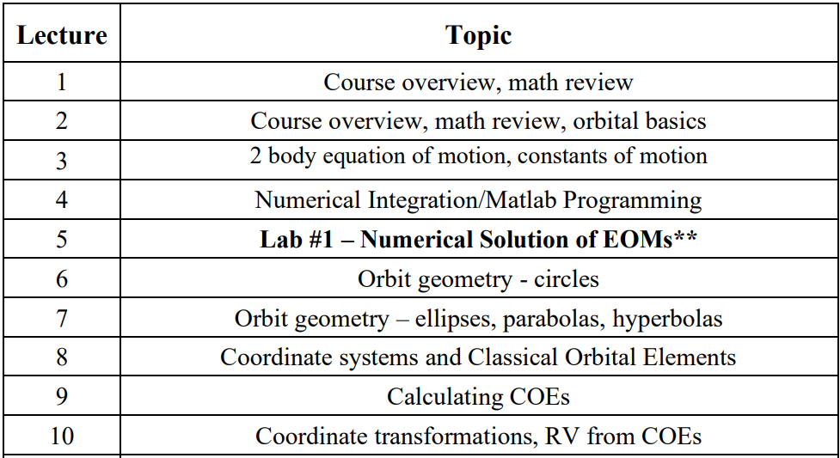
COURSE OVERVIEW

Slide 5
COURSE OUTCOMES
Understand the basic laws of motion and their effect on spaceflight dynamics
Distinguish between different types of orbits
Use Kepler's equations to predict a satellite's future location
Understand the causes and effects of orbit perturbations
Design maneuvers for transferring spacecraft between orbits
Understand the dynamics of spacecraft rendezvous
Perform preliminary design of interplanetary missions
Understand when, where and how to launch spacecraft into orbit
Know the fundamentals of advanced orbital mechanics techniques

Slide 6
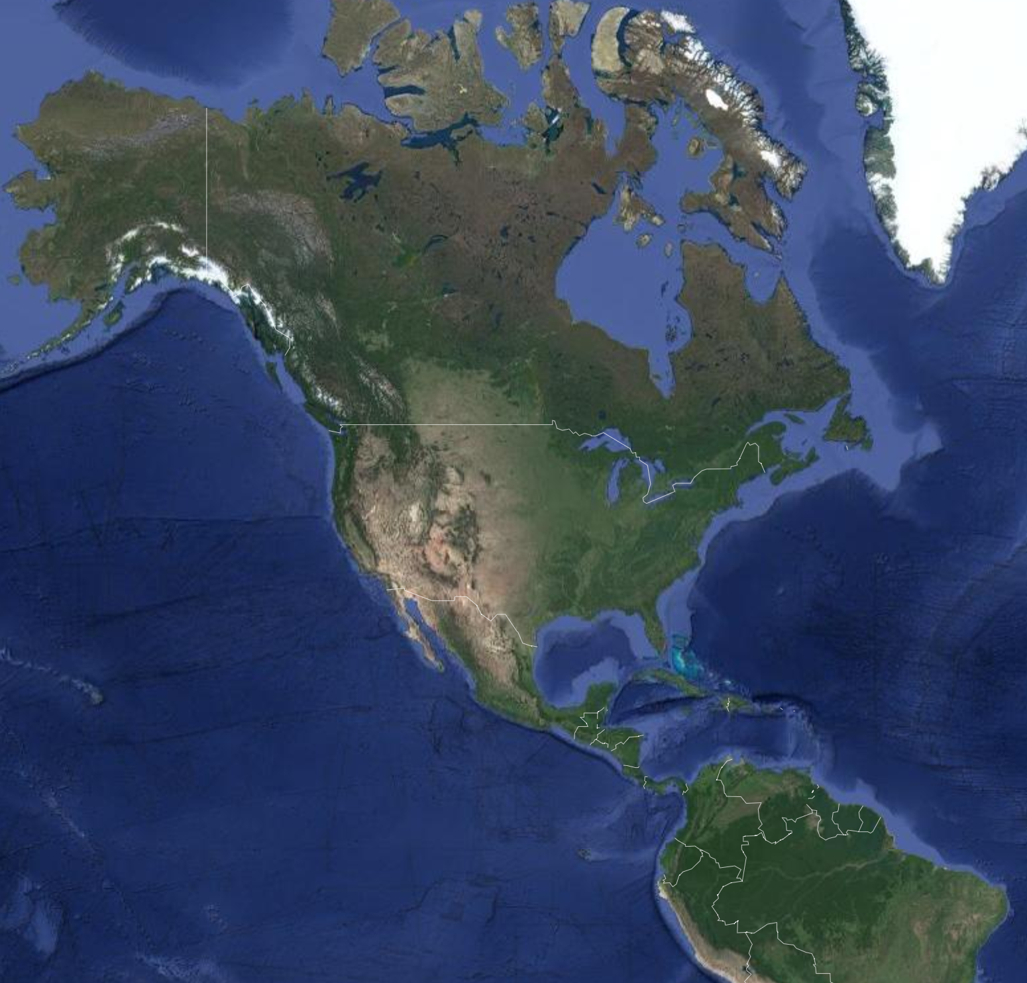
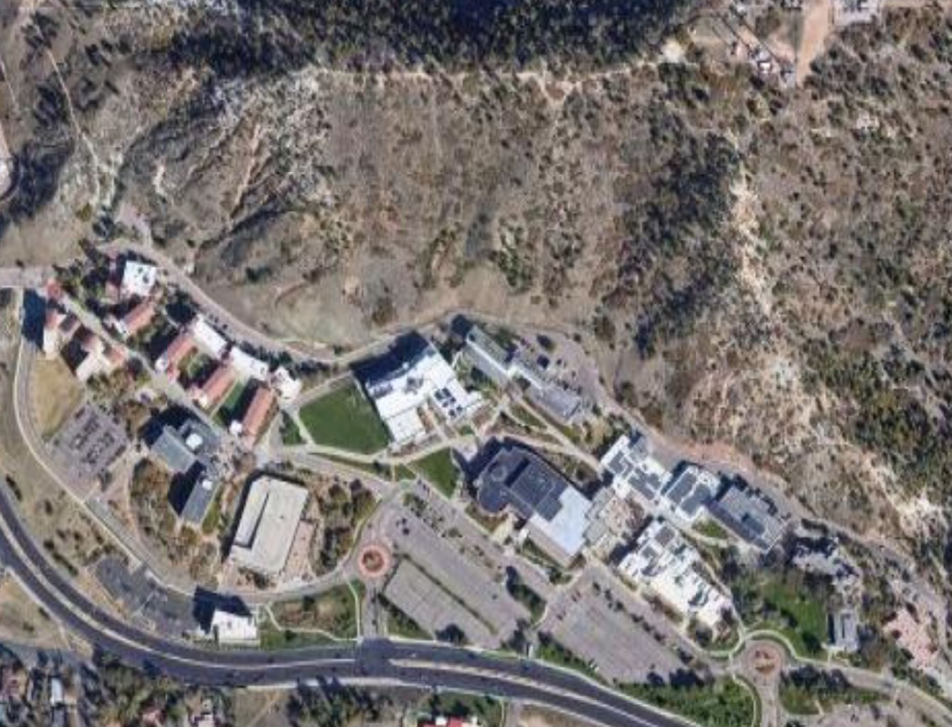
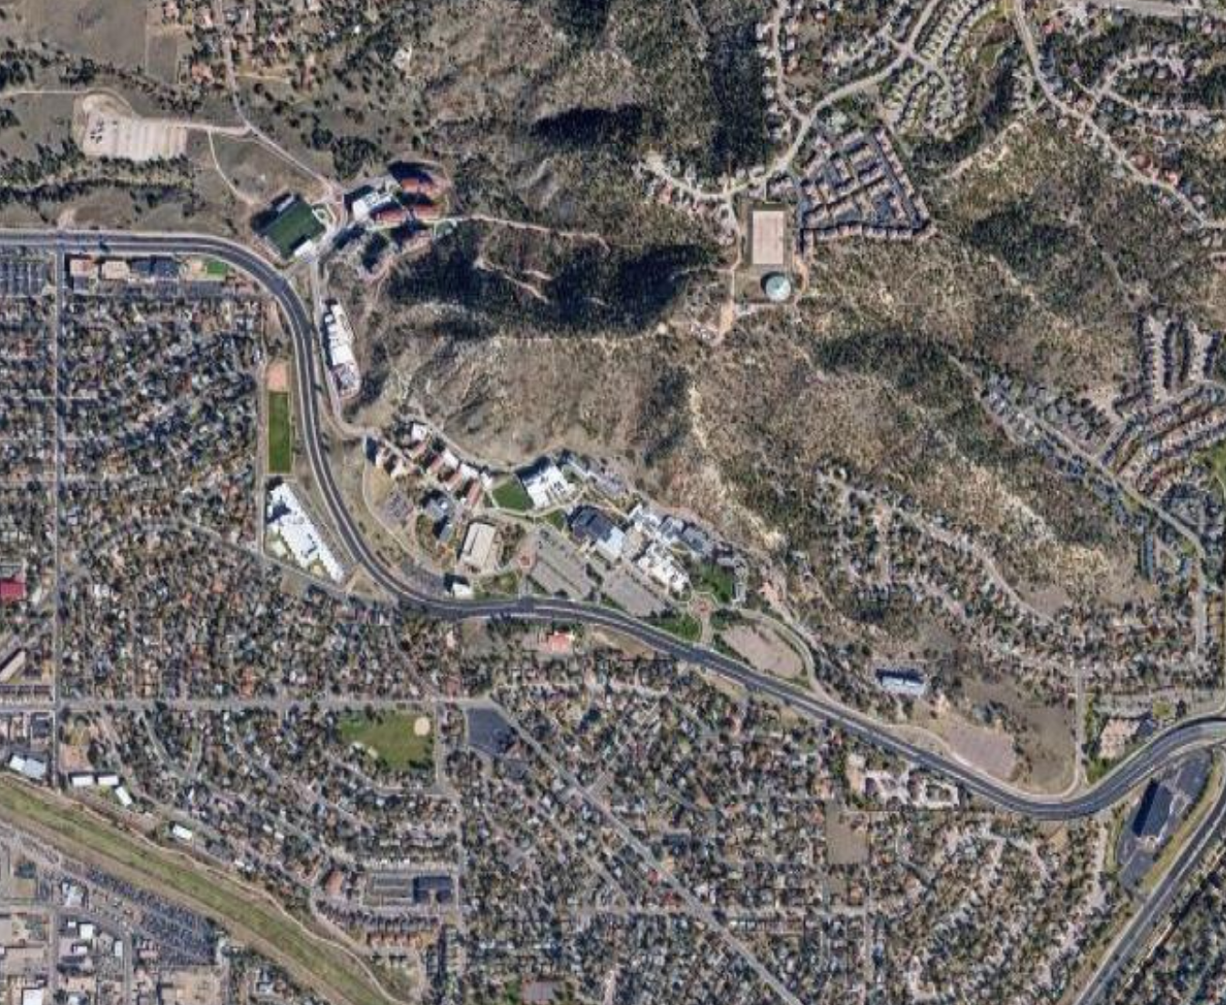
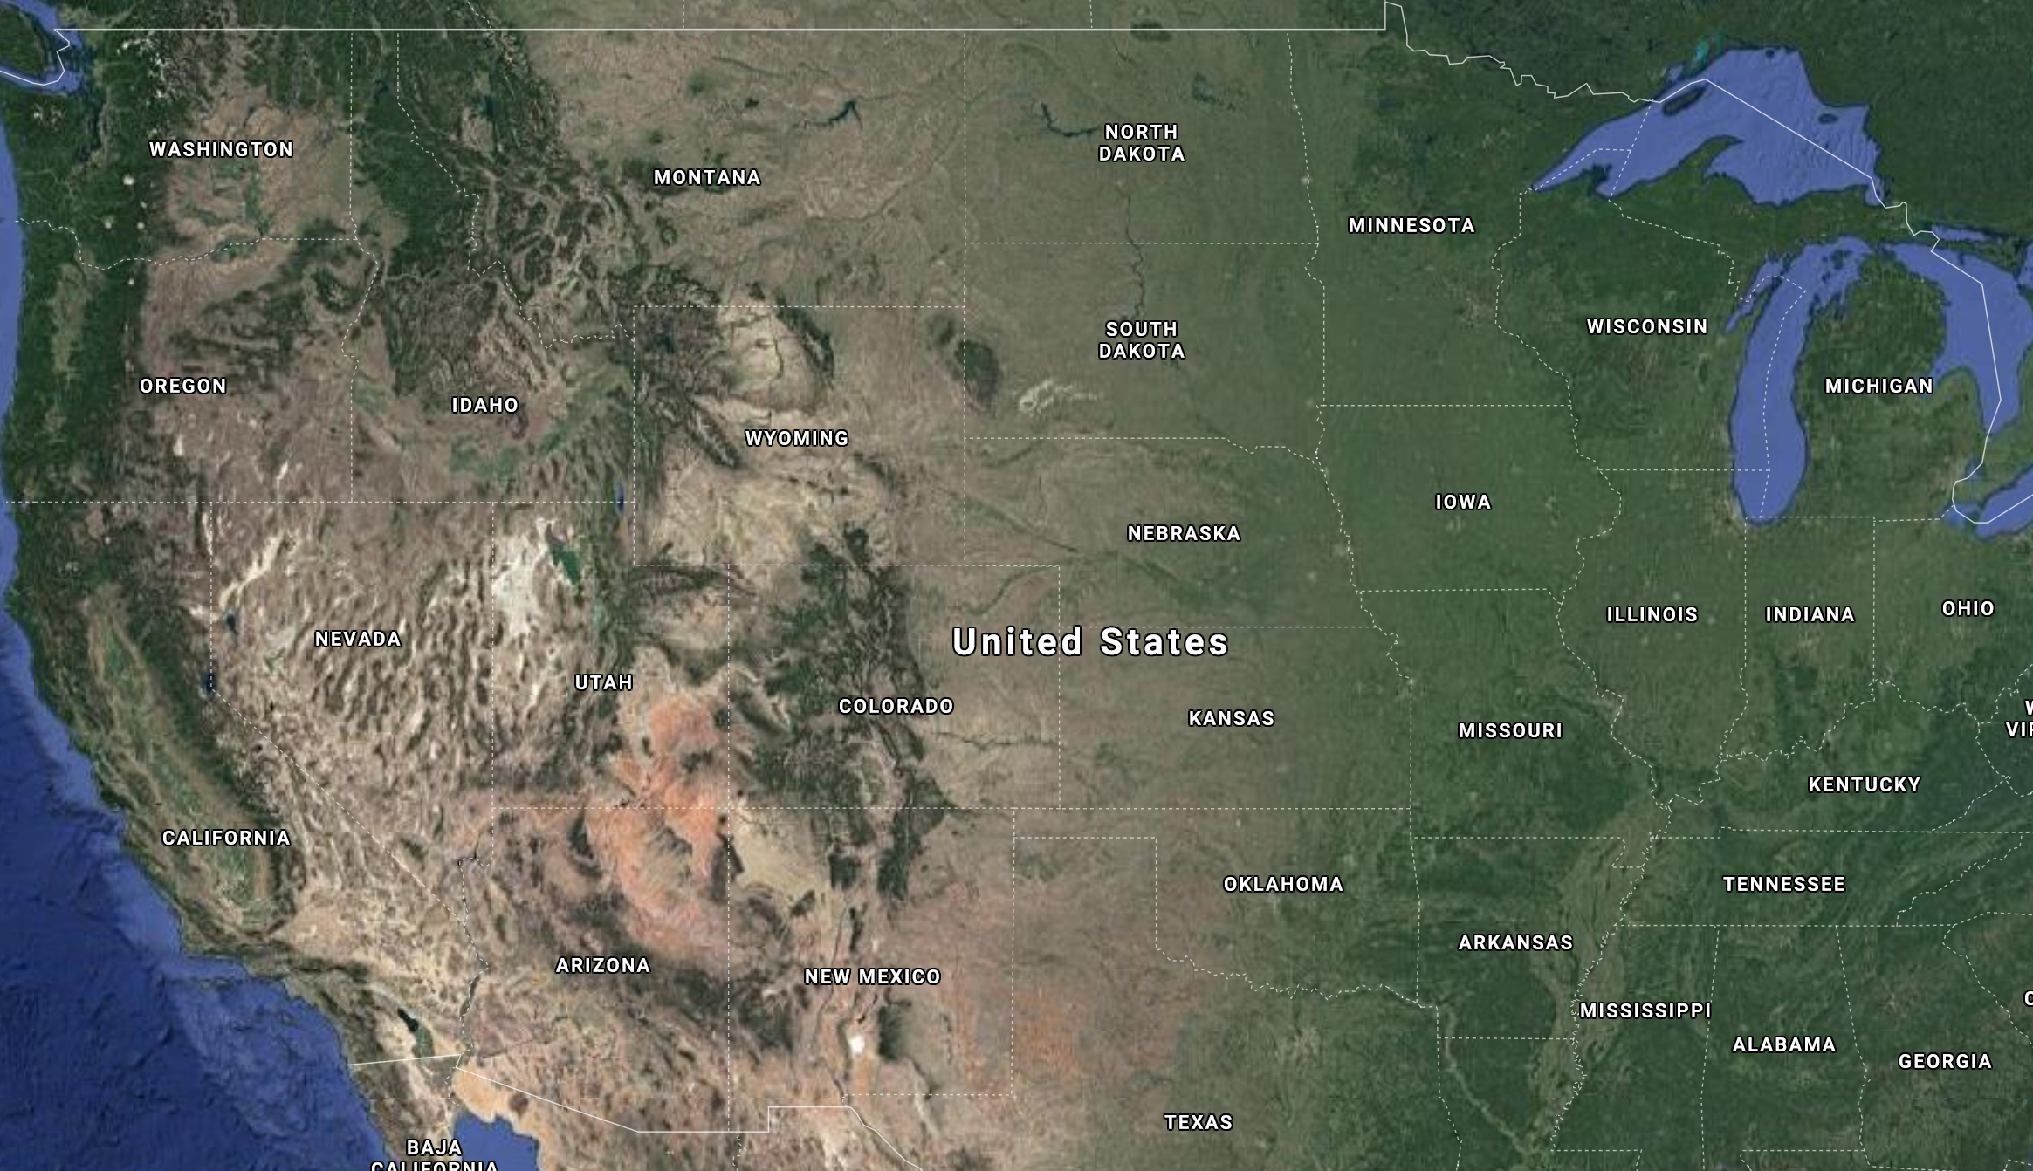
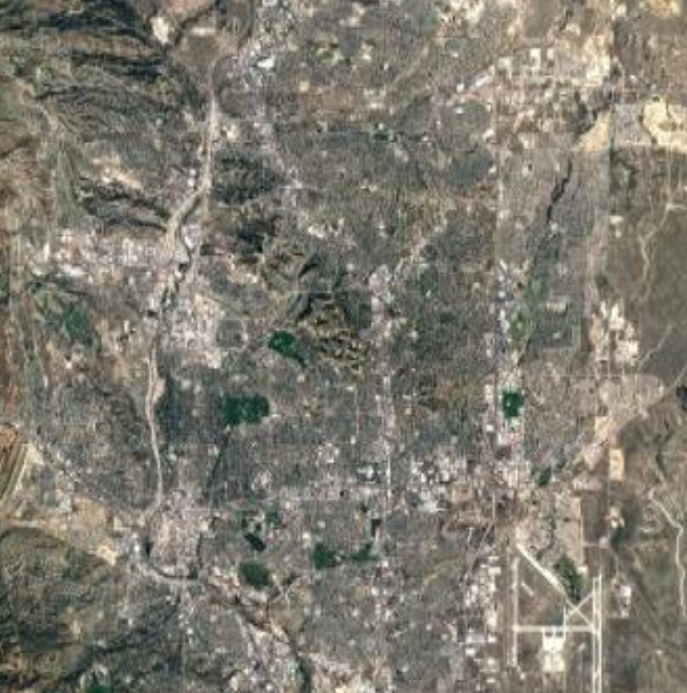
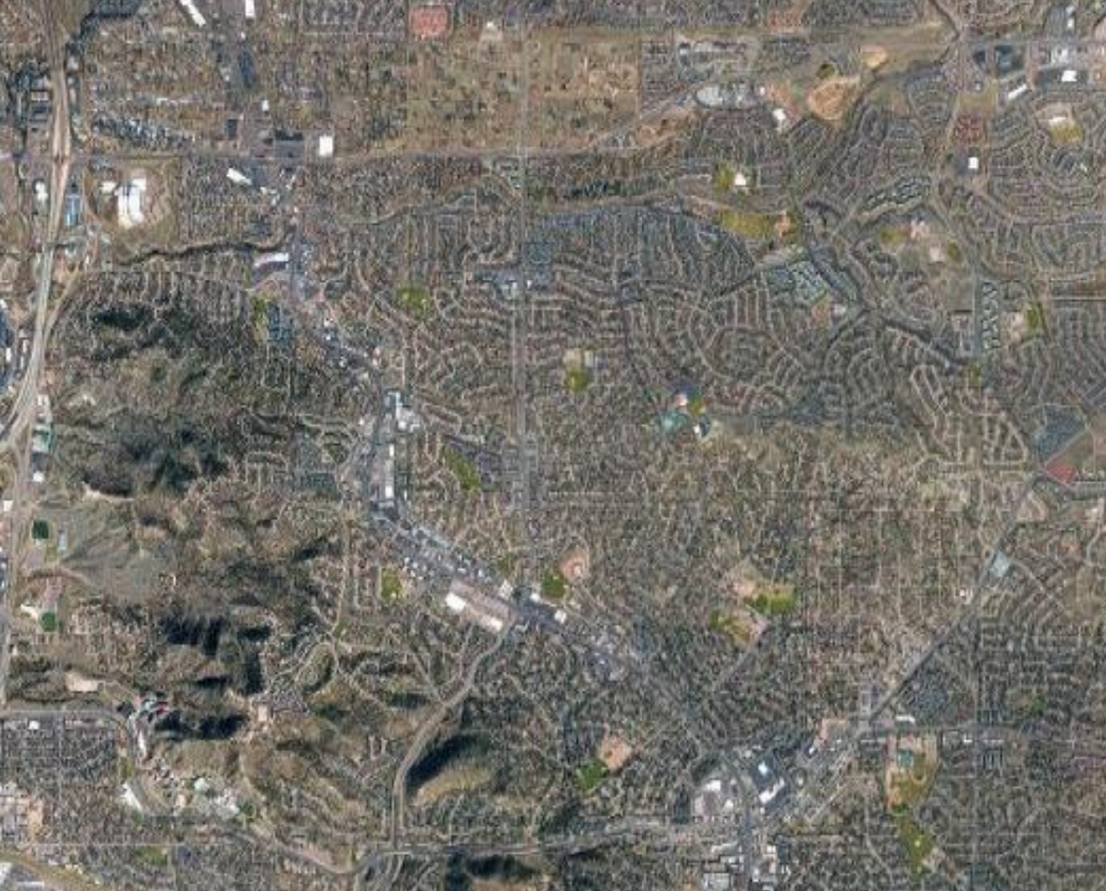
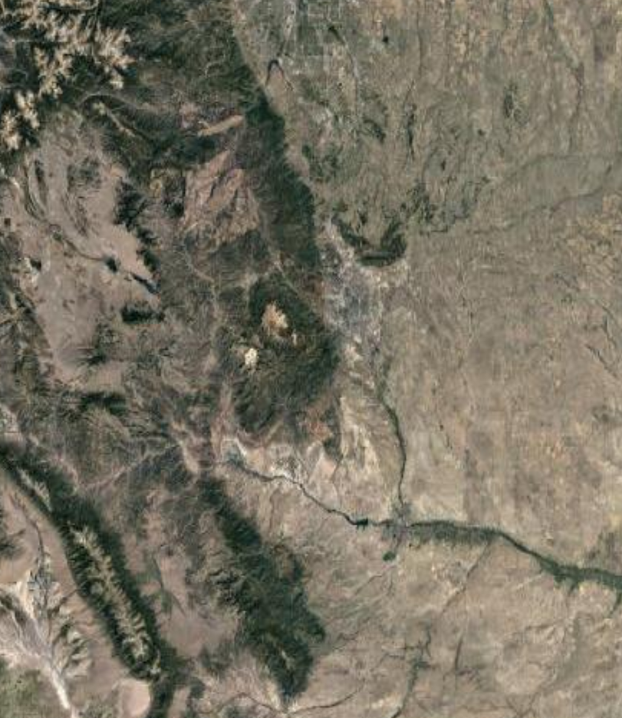
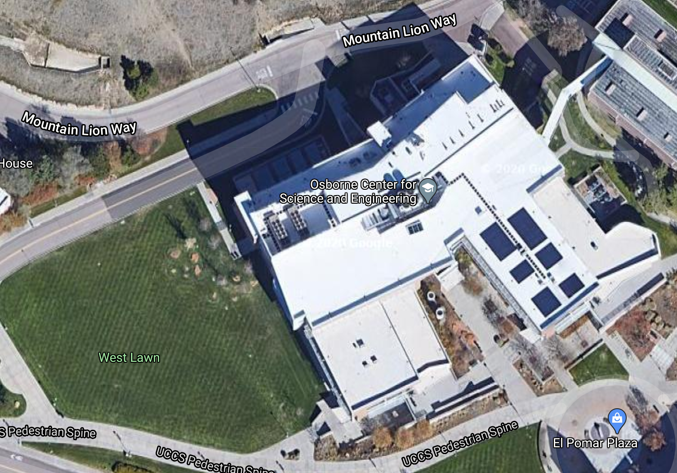
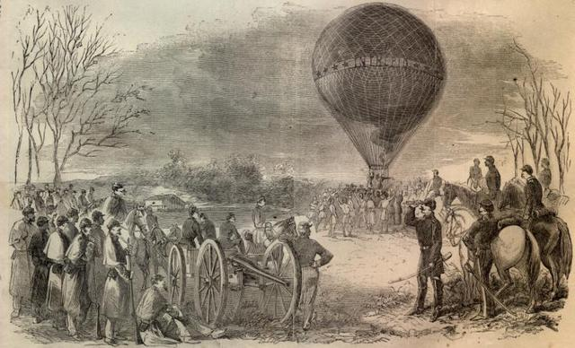
ADVANTAGES OF SPACE
A global perspective – the ultimate high ground

Slide 7
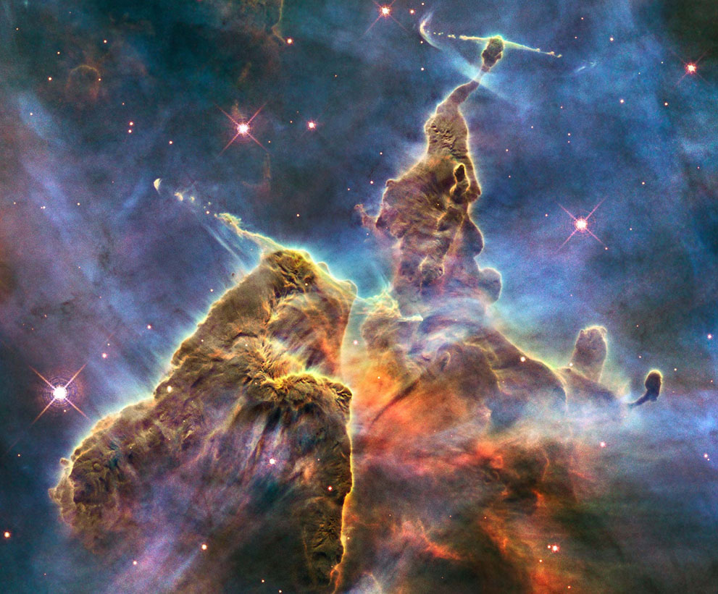
ADVANTAGES OF SPACE
2) A clear view of the heavens – unobscured by atmosphere
Artist’s conception of Kepler-452f-b, the first Earth-size Planet near a star similar to our sun
The Carina Nebula, Hubble Space Telescope

Slide 8
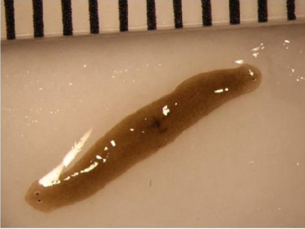
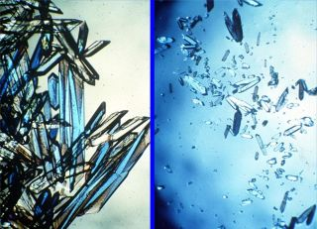
ADVANTAGES OF SPACE
Free fall – no contact forces. The spacecraft is falling toward the earth because of gravity but missing it continually because of its forward speed.
3) A free-fall environment
Animals in Space
Crystal Proteins in Space

Slide 9
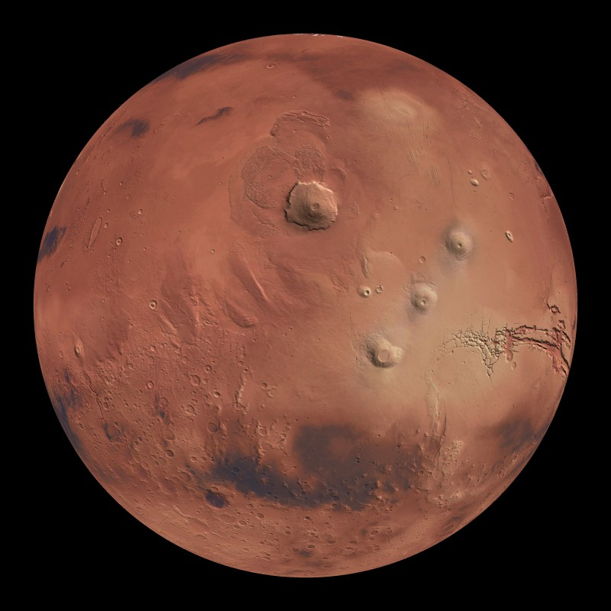
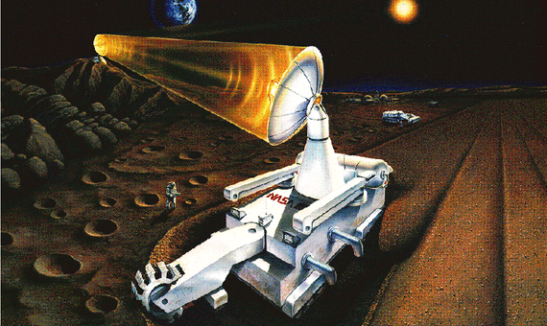
ADVANTAGES OF SPACE
4) Abundant resources – solar energy, minerals, ice
Conceptual Design – Helium-3 Mining

Slide 10
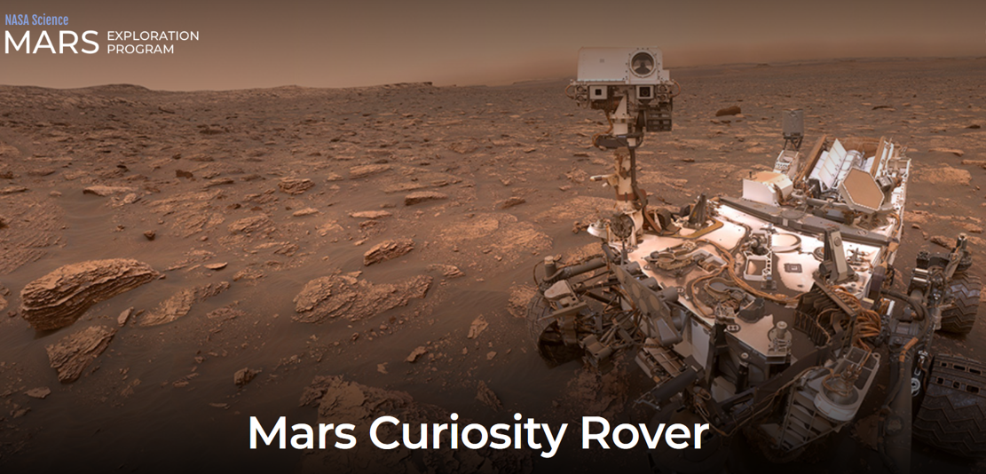
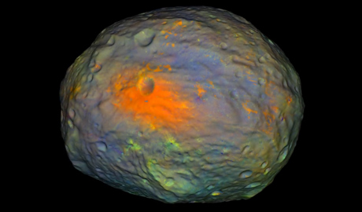
ADVANTAGES OF SPACE
5) Final Frontier!
Vesta 360 as seen from Dawn

Slide 11
REFERENCES
Aeolus. (n.d.). http://www.esa.int/ESA_Multimedia/Images/2003/10/Aeolus
APOD: 2015 February 8 - Carina Nebula Dust Pillar. (n.d.). https://apod.nasa.gov/apod/ap150208.html
Choi, Charles. (2019, April 15). The First Detailed Study Of How Mice Behave In Space Reveals Strange, Coordinated Zooming. https://www.space.com/mice-adapt-to-living-in-space-video.html
Choi, C. (2016, August 17). Space May Be the Best Place to Grow Bone Formation Protein Crystals. https://www.space.com/33770-bone-protein-crystals-grow-better-in-space.html
Dvorsky, George. (2019, April 12). The First Detailed Study Of How Mice Behave In Space Reveals Strange, Coordinated Zooming. from https://www.gizmodo.com.au/2019/04/the-first-detailed-study-of-how-mice-behave-in-space-reveals-strange-coordinated-zooming/
Early U.S. rocket and space launch failures and explosion. (2007, June 28). https://youtu.be/13qeX98tAS8
Fredette, K., Smith, A., Sable, J., & Kasap, H. (n.d.). Space Worms? https://upward.issnationallab.org/space-worms/
Google. (2020). https://www.google.com/maps/@38.8935974,-104.8017887,218m/data=!3m1!1e3
History – Remembering First Landing on Moon – 20 July 1969. (2014, July 20). https://timeglassjournal.wordpress.com/2014/07/20/history-remembering-first-landing-on-moon-20-july-1969/
In Depth. (2019, July 15). https://solarsystem.nasa.gov/missions/kepler/in-depth/
James Webb Space Telescope - Webb/NASA. (n.d.). https://www.jwst.nasa.gov/

Slide 12
REFERENCES
Johnson, M. (2015, July 25). A Spin Around An Exoplanet Most Like Earth. https://www.nasa.gov/image-feature/a-spin-around-an-exoplanet-most-like-earth
Mars Science Laboratory. (2019, September 07). https://mars.nasa.gov/mars-exploration/missions/mars-science-laboratory/
Military History Now. (2012, July 05). The First Air Forces – A Century of Balloons at War. https://militaryhistorynow.com/2012/07/05/early-air-power-100-years-of-balloons-at-war/
NASA Dawn. (2020, November 04). https://solarsystem.nasa.gov/missions/dawn/overview/
NASA Jet Propulsion Laboratory Blog. (2014, May 23). https://www.jpl.nasa.gov/blog/2014/5/vesta-360/
Redd, N. (2017, December 09). Valles Marineris: Facts About the Grand Canyon of Mars. https://www.space.com/20446-valles-marineris.html
Ten Years Aboard the International Space Station. (2010, November 02). https://launiusr.wordpress.com/2010/11/02/ten-years-aboard-the-international-space-station/
Sawe, B. (2017, December 12). What is the Goldilocks Zone? https://www.worldatlas.com/articles/what-is-the-goldilocks-zone.html
Sellers, J. J., & Astore, W. J. (2020). Understanding space: An introduction to astronautics. New York: McGraw-Hill.
StarTrek's Monologue. (2008, January 25). https://youtu.be/S6R3MiAv9ac
Javier, Yanes. (2019, April 01). Helium-3: Lunar Gold Fever. https://www.bbvaopenmind.com/en/science/physics/helium-3-lunar-gold-fever/

Slide 13
VIDEOS
Mice aboard the International Space Station. (2019, April 11). https://youtu.be/q7lgj3aZ8dU

